Slide 1
Kilby School Advisory Council February 2026
Agenda-
Information from Superintendents Advisory Council on Instruction
English Language Learner Information (WIDA ACCESS testing)
Upcoming Events (Career Day)
Hazel Health information
Title 1 information
Mid-Year Assessment
Notes:
The Code of Behavior:
Establishes the expectations for student behavior to enhance school safety and learning.
Outlines the expectations, rules, and consequences for student behavior in Prince William County Public Schools (PWCS).
It’s important for students to understand these expectations and adhere to them.
If you don’t understand the rules and what is expected of you, ask for help! It is your responsibility to ask an adult to help you understand.
Our school staff is here to help you to be successful!

Slide 2

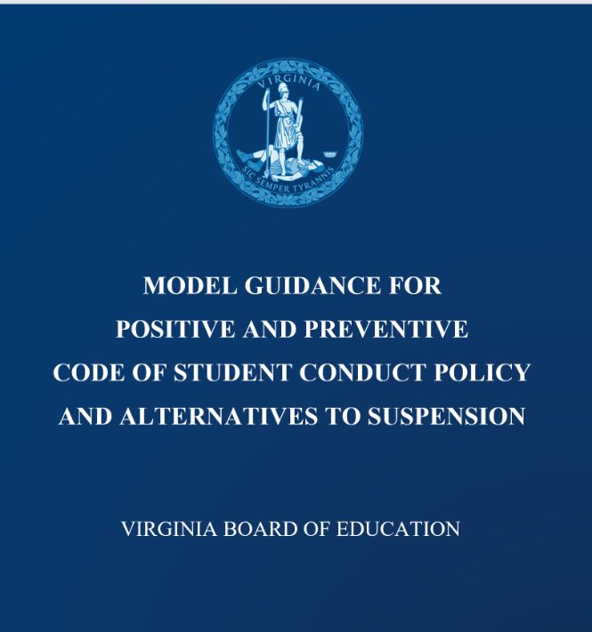
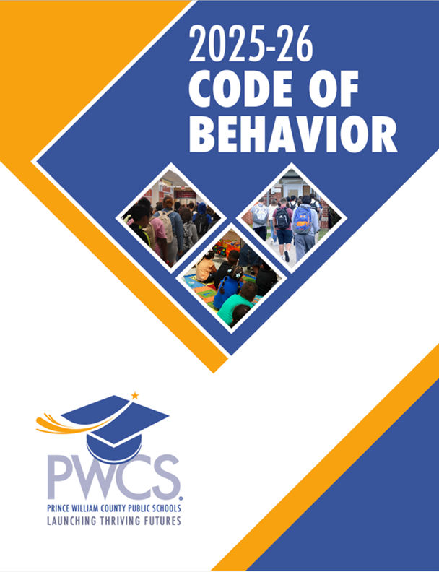
“Code of Behavior”
Implementation
Code of Virginia
PWCS School Board
School Site
VA Board of Education
Notes:
The Virginia Board of Education created the Model Guidance for Positive and Preventative Code of Student Conduct Policy and Alternatives to Suspension
PWCS School board created the COB
School site utilize PWCS COB for managing student conduct. The school site educates the students yearly on the COB. Schools establish and then implement a clear, consistent, restorative process consistent with local board policy.

Slide 3

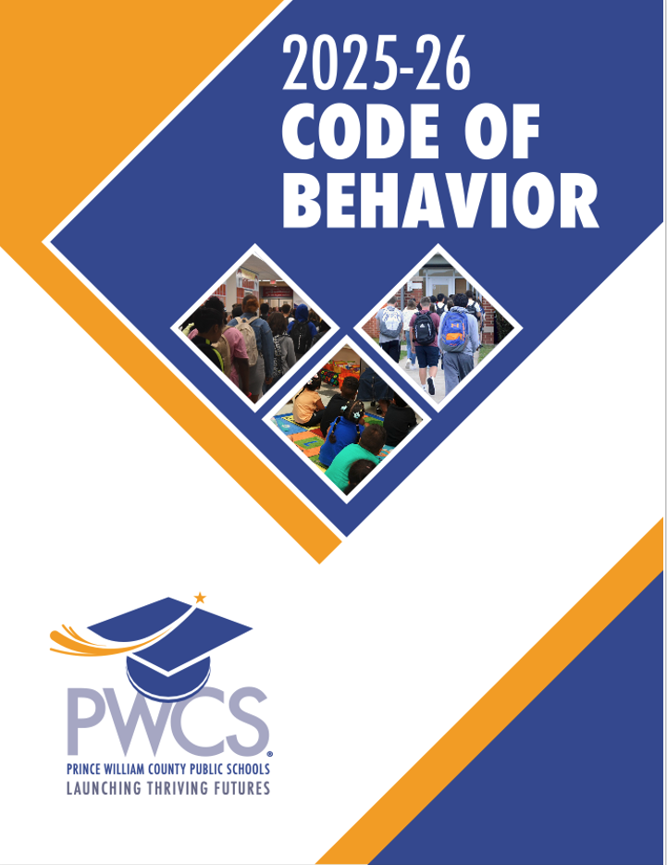
Purpose of the Student Code of Behavior
Establishes the expectations for student behavior to enhance school safety.
Supports preventative and age-appropriate responses to discipline before resorting to exclusionary practices.
Provides access to quality education and behavioral interventions for students who are removed from the classroom.
Encourages partnerships with students and families to improve school climate and learning conditions.
Notes:
Purpose of the Code of Behavior: The Code of Behavior establishes clear expectations for student conduct, aiming to create a safe and focused learning environment that facilitates access to quality instruction. It details expected behaviors, student rights, and consequences for violations.
Shared Understanding and Positive Behaviors: Implementing the Code of Behavior requires a shared understanding among students and educators. Establishing common ground on positive and negative behaviors is crucial. Beyond the rules, students need strategies for success, and teaching these strategies significantly contributes to their achievement.
Fostering a Supportive Environment: A supportive and respectful learning environment is essential for student success. When students feel safe and respected, they are more likely to thrive academically.
Preventative Practices and Restorative Practices: Preventative Practices, including Restorative Practices, aim to help students succeed by addressing issues before they escalate. Restorative Practices focus on learning from situations that led to violations, offering strategies for growth without replacing consequences.

Slide 4

Accessing the COB:
The COB is presented by administration to students in all grades at the beginning of each school year and as new students enroll in PWCS division.
Families and school staff are notified at the beginning of each school year on the COB and how to access it online.
Families may request a hard copy of the COB provided in 9 different languages, including English, from their student's school.
Notes:
Highlight MTSS – we ask about the interventions that have been provided for the student and data to support the growth or not
SBAR: Student Behavior and Administrative Response VDOE: Levels 1 through 5 broken into grade levels PK-2; 3-5 and 6-12
Level 4 Responses: Short Term Suspense: PreK-3 one to three days, Grades 4-6 four to ten days and Grades 7-12 five to ten days
Possible recommendation for long-term suspension 11 to 45 days
Level 5 Responses: Referral to the Student Hearings Department for Further Disciplinary Action; Long-Term Suspension – 11 to 45 days as defined by VA Code 22.1-276.01; Alternative Placement; Expulsion

Slide 5

Areas of Focus for the COB:
Awareness and Expectations.
Multi-Tiered Systems of Support and Restorative Practices.
Leveled systems of responses to COB violations.
Clarification of behavior definitions.
Alignment with PWCS’ policies, regulations, and procedures.
Cultural Competency.
    Community and Family Engagement.
    Equitable and Inclusive Language.
    VDOE Standard VI Cultural Competency Framework.
Notes:
Highlight MTSS – we ask about the interventions that have been provided for the student and data to support the growth or not
SBAR: Student Behavior and Administrative Response VDOE: Levels 1 through 5 broken into grade levels PK-2; 3-5 and 6-12
Level 4 Responses: Short Term Suspense: PreK-3 one to three days, Grades 4-6 four to ten days and Grades 7-12 five to ten days
Possible recommendation for long-term suspension 11 to 364 days
Level 5 Responses: Referral to the Student Hearings Department for Further Disciplinary Action; Long-Term Suspension – 11 to 45 days as defined by VA Code 22.1-276.01; Alternative Placement; Expulsion (365 days)

Slide 6
Changes to the COB 2025-2026:
Student Voice Bill of Rights
Student Behavior and Administrative Response (SBAR) codes
Leveling Interventions and Discipline Responses
Notes:
Highlight MTSS – we ask about the interventions that have been provided for the student and data to support the growth or not
Behavior codes are aligned with state guidelines, "Student Behavior and Administrative Response" (SBAR) codes.
Tiered responses to student misconduct is aligned with "Leveling".
SBAR: Student Behavior and Administrative Response VDOE: Levels 1 through 5 broken into grade levels PK-2; 3-5 and 6-12
Level 4 Responses: Short Term Suspense: PreK-3 one to three days, Grades 4-6 four to ten days and Grades 7-12 five to ten days
Possible recommendation for long-term suspension 11 to 364 days
Level 5 Responses: Referral to the Student Hearings Department for Further Disciplinary Action; Long-Term Suspension – 11 to 45 days as defined by VA Code 22.1-276.01; Alternative Placement; Expulsion (365 days)

Slide 7

Student Behavior and Administrative Responses (SBAR)
6 Categories per Code of Virginia:
SBAR Code | Description
BAP | Behaviors that Impede Academic Progress
BESO | Behaviors that Endanger Self or Others
BSC | Behaviors that Present a Safety Concern
BSO | Behaviors Related to School Operations
RB | Relationship Behaviors
PD | Persistently Dangerous
Notes:
SBAR: Code of Virginia (§22.1-279.3:1) requires school divisions statewide to submit data annually to the Virginia Department of Education (VDOE)
Aligning PWCS discipline to the state SBAR Codes was a change to the 2025-2026 Code of Behavior. Additionally, providing leveling guidance for interventions and disciplinary consequences is provided in the COB.
Examples:
BAP – Scholastic Dishonesty, Interfering with Learning (off-task, out of seat)
BESO – Assault, Fight, Threat
BSC – Alcohol, Drugs, Bullying WITH injury
BSO – Refusing staff request, Gambling, Violation of Tech Policy
RB – Bullying, Profane Language, Stealing without physical force – RB NO PHYSICAL HARM IS DONE
PD – Persistently Dangerous – possession of handgun, bomb

Slide 8

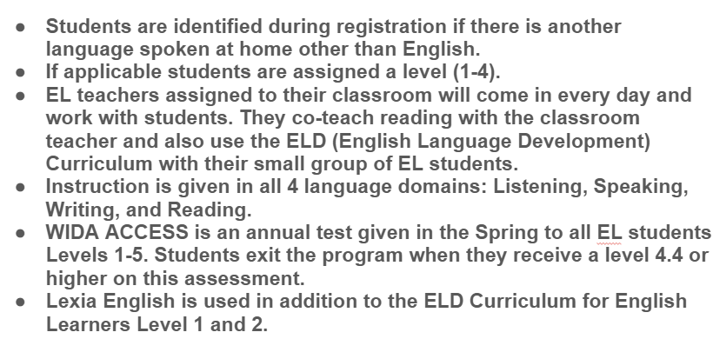
English Language Information
EL (English Learner) Program

Slide 9
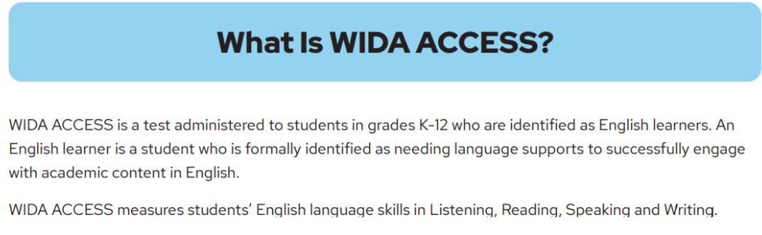

Slide 10
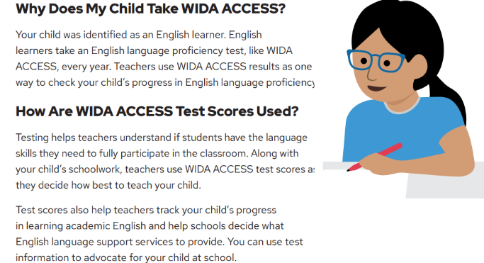

Slide 11
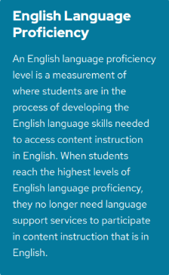

Slide 12


Career Day :
When: Thursday, March 19th from 9:00 to 2:45.
Kilby is looking for presenters to talk about what they do for a living
Purpose is to make learning engaging and inspire diverse futures.
Please reach out to Dr. Minckler or Ms. Hart for more information or additional questions.
We look forward to seeing you!

Slide 13

Hazel Health

Slide 14
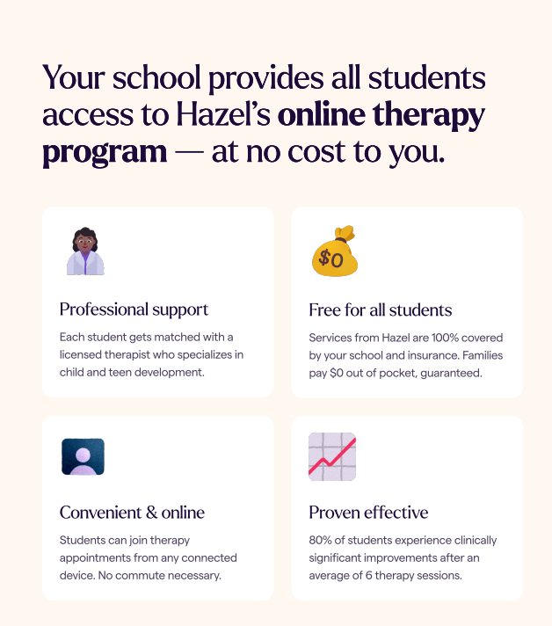
Hazel Health

Slide 15
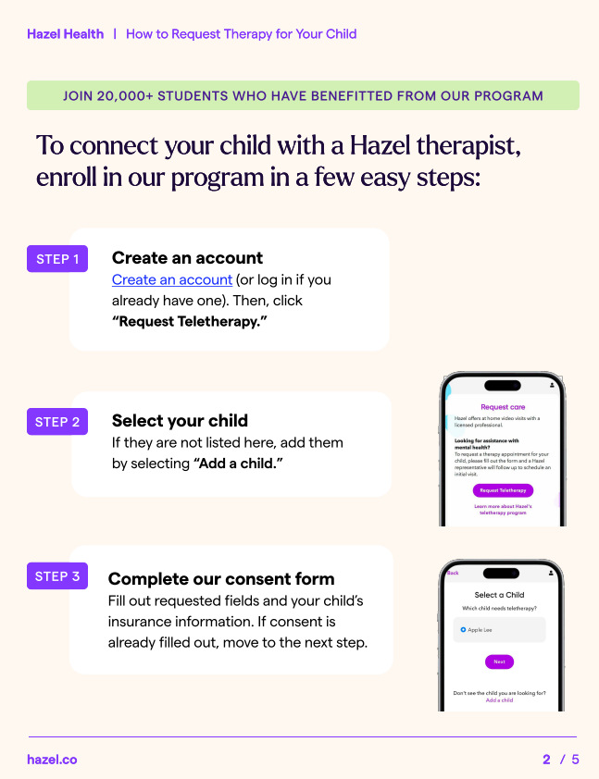
Hazel Health

Slide 16
Title 1 information
Thursday, February 26th: For the LOVE of Math Night (Schoolwide Math Night)
Thursday, March 12th: LUCKY Literacy Quest Night (Schoolwide Literacy Night)

Slide 17
Mid-Year Testing
VALLSS (Virginia Literacy and Literacy Screening System) KG-5th grade students who scored in the High Risk and Moderate Risk in the fall.
Momentum Math 1st-5th grade
*Unit tests are throughout the year

Slide 18
Closure

